Slide 1
Combining mechanistic modeling with big data to better understand vascular systems and allometric scaling
by
Van Savage
Department of Ecology and Evolutionary Biology
Department of Biomathematics
Quantitative and Computational Biology Institute
UCLA
External Faculty
Santa Fe Institute
USC, April 18, 2016

Slide 2
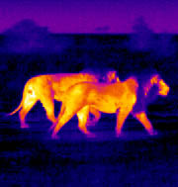
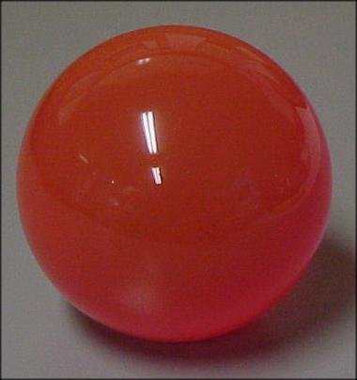


metabolic rate—“fire of life”—power for
maintenance, growth, and reproduction
metabolic rate=heat loss rate surface area (volume)^{2/3}
Stefan-Boltzmann law
“isometric scaling”
shape stays same
“Allometric scaling”
shape changes
Animals are not isometric, so may not be 2/3
If you were the Matrix, would you choose humans as batteries?
Notes:
Isometry vs allometry is really a biological way of saying isomorphic vs allomorphic. Isometry means distances stay the same, so size and general shape is preserved. But here, we actually mean just shape. Difficulty of talking to multiple depts is that people often use different terms for the exact same thing or the same term for different things, Here is biology trying to borrow a term from math, but it is not used quite correctly. Here isometry means something closer to geometric similarity or congruence. I don’t want terminology to be a stumbling block, so I try to be clear, but alsi please ask questions if it isn’t.

Slide 3
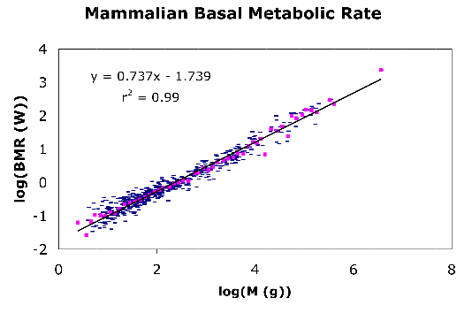
mass dependence of metabolic rate
Slope=0.74+/-0.03
r²=0.99
Log(basal metabolic rate (W))
Log(body mass (g))
Savage et al., Func. Eco., 2004

Slide 4
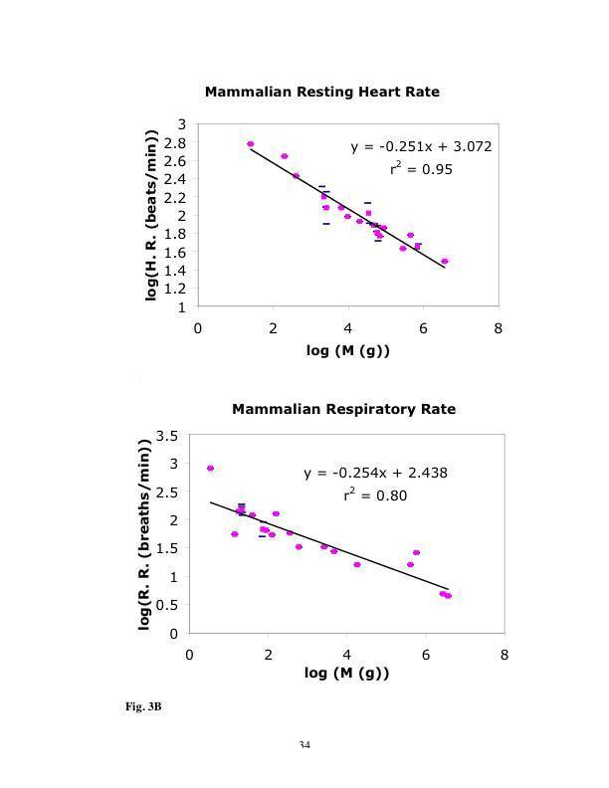
Typical Mass-Specific Rates
Savage, et al., Func. Eco., 2004

Slide 5
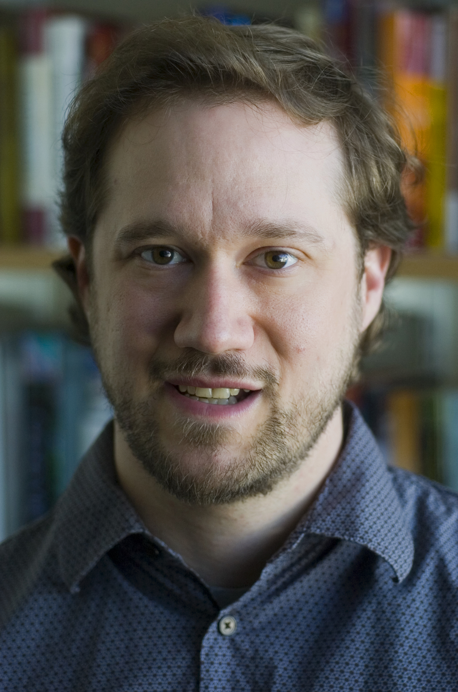
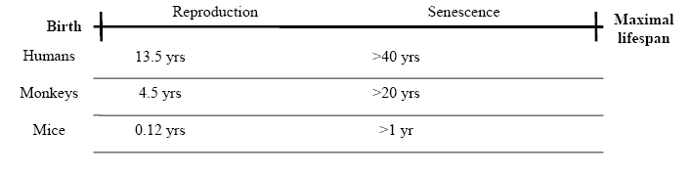

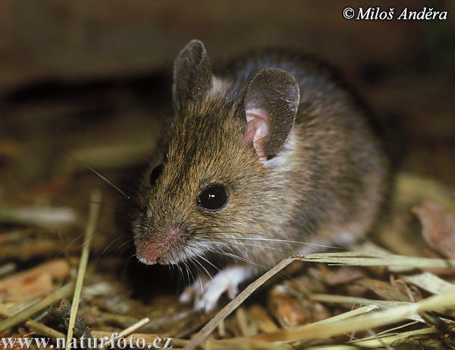
scaling of life stages
Has been called Kepler’s laws for organisms, ecology, etc.
www.senescence.info
Notes:
Lifespan data. Say axes. And talk about orgs.

Slide 6
vascular networks

Slide 7
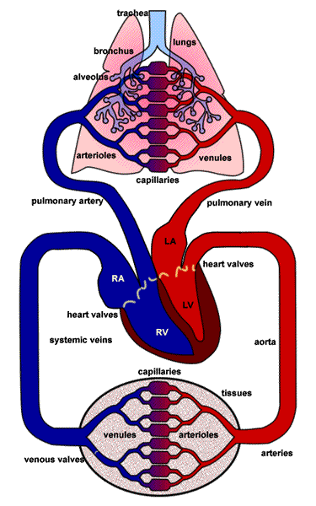
focus on hierarchical, branching network
level 2
branching
ratio
level 1
level 0
level 2

Slide 8

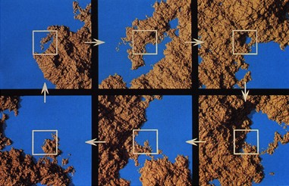
Power laws always tied to self similarity and vice versa
(if and only if)
Notes:
Ask them why self similarity might be expected in Nature??
Biochemical reactions, genetic conservation, structure of cardiovascular system and
Plant architecture

Slide 9
General expressions for scaling ratios of vessel lengths and radii
and
Notes:
Say this holds as long as 2a+b>0

Slide 10
base model has three assumptions
Minimization of power to deliver resources
constraint on vessel radii
ii. Space filling to feed all cells
constraint on vessel lengths
iii. Capillaries are invariant in size
sets overall scale for network
West et al., Science, 1997
Savage et al., PLoS. Comp. Biol., 2008

Slide 11
energy minimization
Reflection at junctions (important for larger vessels, pulsatile flow)
T
R
I
T
area preserving
Dissipation (important for small vessels, Poiseuille flow)
area increasing
West et al., Science, 1997
Savage et al., PLoS. Comp. Biol., 2008
Notes:
The transition between these two turns out to be to crucial for what I will tell you in going ahead, but for now let me just say that this transition always happen the same number of levels (about 10-15) counting backward from the capillaries regardless of body size or species, whether in a mouse or an elephant. This will be an important point later because it is one of the weakest parts of the model and is based on an incorrect calculation. Found by equating impedances, which might make sense because that is where energy loss would be equal for the two regimes, except (!) energy loss due to reflections does not just depend on linearly on impedance.

Slide 12
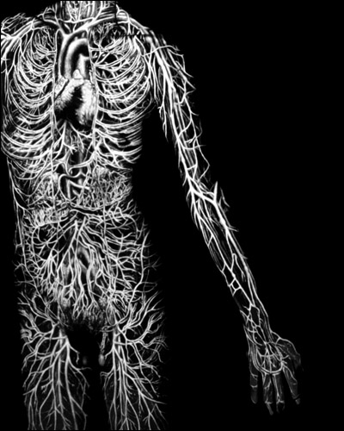
Space-filling,
Hierarchical,
Branching network
Katherine Du Tiel, 1994

Slide 13
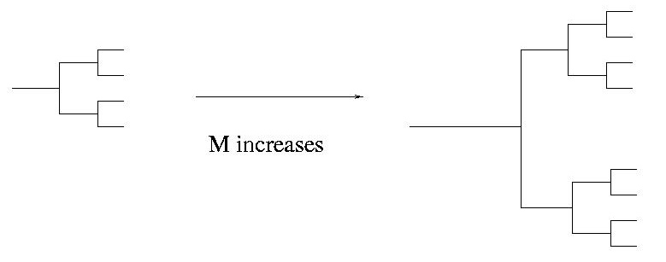
Body size changes network size
terminal units are invariant
Capillaries
Aorta
Level 0
level
Level 1
Notes:
WE ASSUMS CAPILLARY AND RED BLOOD CELL SIZE ARE THE SAME FOR
ALL ORGANISMS. TAKING THE CAPILLARY SIZE AS A GIVEN, WE CAN THEN
USE THE SCALING RELATIONS FROM THE PREVIOUS TWO SLIDES TO KNOW THE RADIUS
AND LENGTH OF VESSELS ONE LEVEL BACK, AND THEN REPEAT THAT TO KNOW
THE RADIUS AND LENGTH ONE LEVEL BACK FROM THAT AND SO ON IN ORDER TO DETERMINE
THE STRUCTURE OF THE ENTIRE NETWORK.
IF ASKED, THE MASS AND VOLUME OF THE ORGANISM DETERMINE THE VOLUME AND
MASS OF THE NETWORK, AND THAT IN TURN DETERMINES THE NUMBER OF LEVELS THAT
CORRESPONDS TO THIS VOLUME. HENCE IN SCALING ACROSS ORGANISMS, WE ARE ACTUALLY
SCALING ACROSS THE NUMBER OF LEVELS IN THE NETWORK OR CORRESPONDINGLY,
THE NUMBER OF CAPILLARIES IN THE ORGANISM.

Slide 14
metabolic rate and body mass
number of
capillaries
capillary
volume
blood
volume
body
mass
met
rate
leading
order
follows from
energy min.
and
space filling
invariance of
terminal units
B=N_{cap}B_{cap}
use scale factors
to relate each level
to terminal units
Replace spherical cow with non-spherical but infinitely large cow.
West et al., Science, 1997

Slide 15
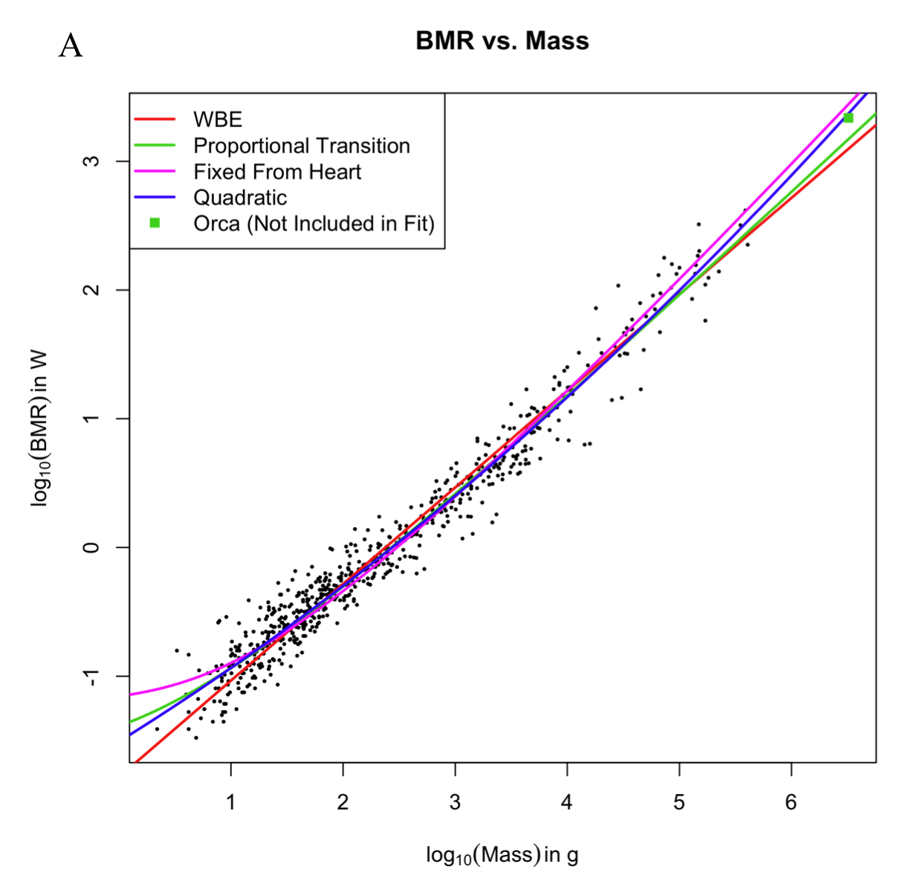
deviations from theory
Kolokotrones, Savage, et al., Nature, 2012

Slide 16
What is wrong with the vascular models? Data and tests for self similarity in vascular networks

Slide 17
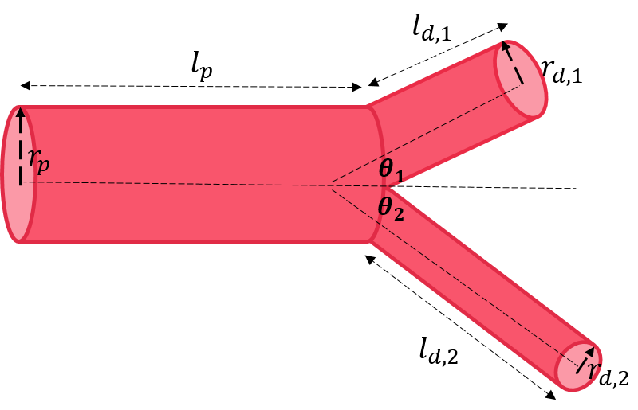
branching junction measurements

Slide 18
4 measures of scaling exponents— interchangeable?
Conservation Based—LOCAL—single branching junction
and
Ratio Based—LOCAL—single branching junction
and
Regression Based—GLOBAL—uses all data across branching levels
and
Distribution Based—GLOBAL—uses all data across branching levels
and
Newberry, Ennis, Savage, PLoS Comp Biol, 2015
Notes:
Say this holds as long as 2a+b>0

Slide 19
Why do we need more or better data?
Each species has one or at most a few individuals so hard to characterize variation across species, individuals, or even levels of network
Variation exists because different geometries are known to exist and we just presented simplified picture
Looking more deeply at variation may be important for diagnostics or understanding of pathologies and tumor vasculature
Data were destructively measured, possibly making measurements unreliable and making it impossible to track development of vascular systems
Difficult to measure full range (4 orders of magnitude) of vessel sizes in this way

Slide 20
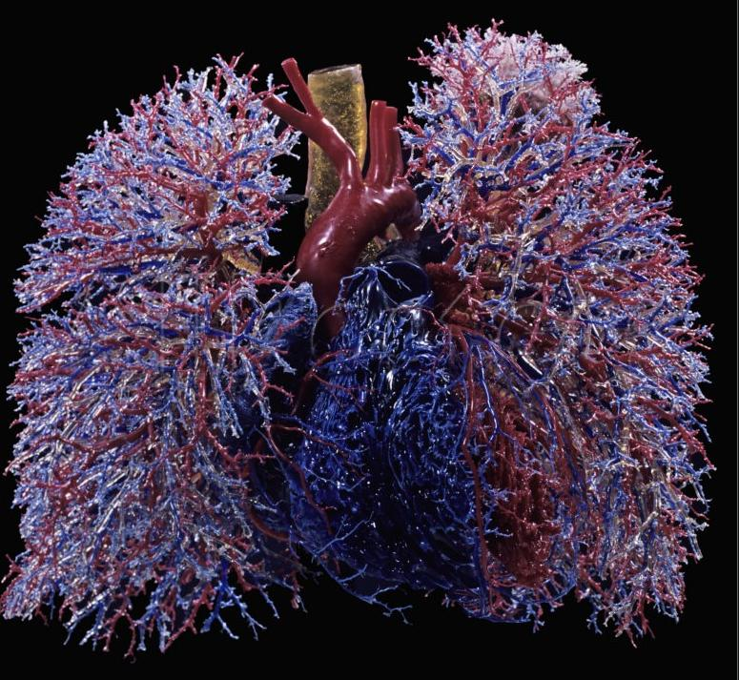
limited data destructive casting techniques

Slide 21
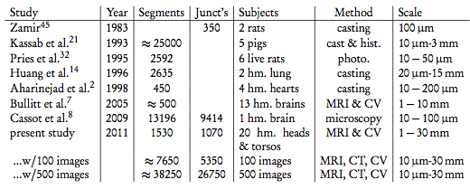
number of individuals
Newberry and Savage, PLoS Comp Biol 2015
Notes:
People did these before mostly by plasticene casts, like in Body Worlds, and then went in with calipers and measured by hand, and it took months and months to get these data.
I worked with masters students to develop software to get these from angiographic images (here specifically MRI), and during his defense, he was able to produce 1000s of measurements in 15 mins during his talk.
Could now easily equal largest study ever. Plus, I’ve asked, and largest study ever is in handwritten notes that won’t be digitized by Zamir or won’t be shared at all by Kassab. Presumably because it was so much work. We will make data public as part of our first publication.

Slide 22
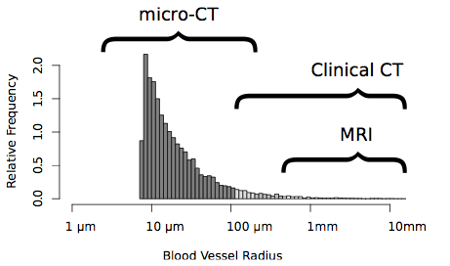
imaging technologies now span full range of vessel sizes
Newberry, Ennis, Savage, PLoS Comp Biol, 2015

Slide 23
algorithm for extracting data

Slide 24
steps in algorithm
Newberry, Ennis, Savage, PLoS Comp Biol, 2015

Slide 25

choose threshold for intensity and find largest connected component
Newberry, Ennis, Savage, PLoS Comp Biol, 2015

Slide 26
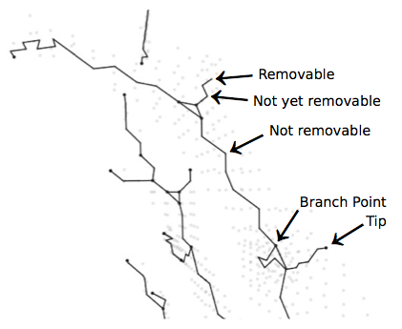
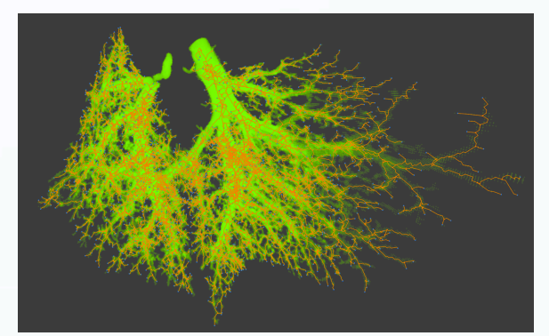
erosion algorithm to find skeleton and branch points
Johnson, Ennis, Savage, PLoS Comp Biol, in review

Slide 27
MRI human head and torso
Newberry, Ennis, Savage, PLoS Comp Biol, 2015
Notes:
Take off pixels, and if it divides component in two, then it is not a tip. If it does not, it might be a tip. Can do this iteratively pixel by pixel through erosion.
MENTION THAT IT IS GREAT STUDENT PROJECTS TO EXTEND THIS CODE AND LOOK AT THESE TYPES OF DATA MORE DEEPLY.

Slide 28
micro-CT mouse lung
Kristina Bostrom’s data

Slide 29
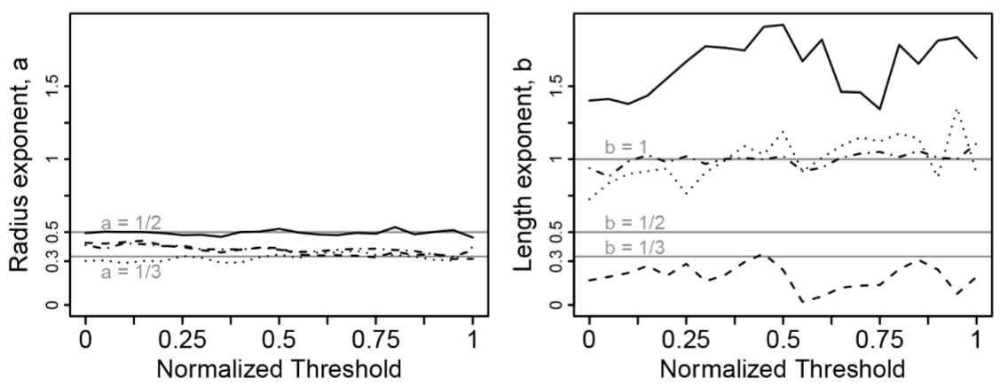
results and sensitivity analysis
Newberry, Ennis, Savage, PLoS Comp Biol, 2015

Slide 30
focus on hierarchical, branching network
level 2
branching
ratio
level 1
level 0
level 2

Slide 31
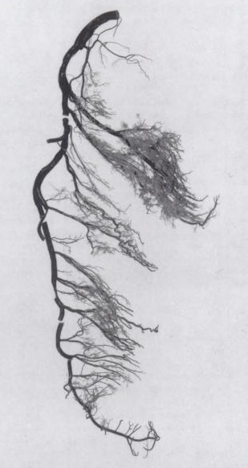
asymmetric branching in left coronary artery

Slide 32
characterizing asymmetry

Slide 33
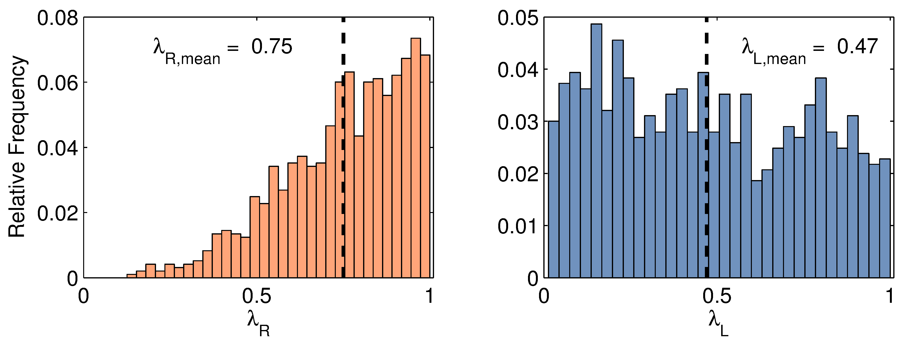
asymmetry distributions
Ratio of smallest to largest child radius or length at single branching junction
symmetry=1
Hunt and Savage, Phys. Rev. X, in review

Slide 34
predictions based on optimal models

Slide 35
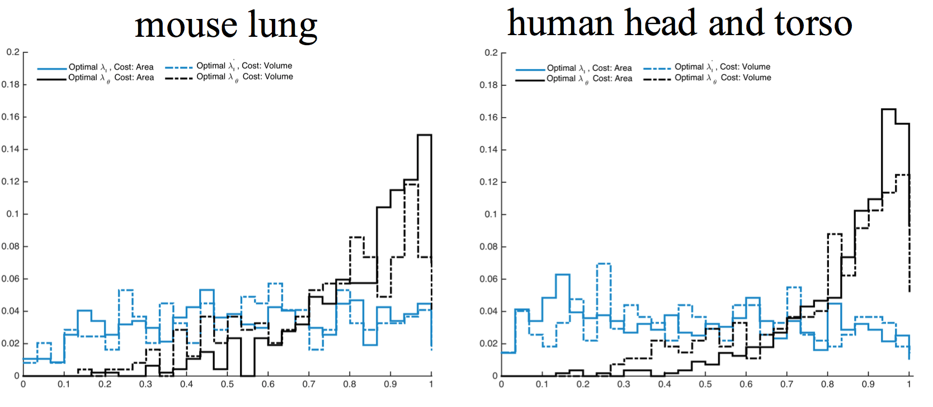
network-level comparison for optimized construction costs
Tekin and Savage, in prep.

Slide 36
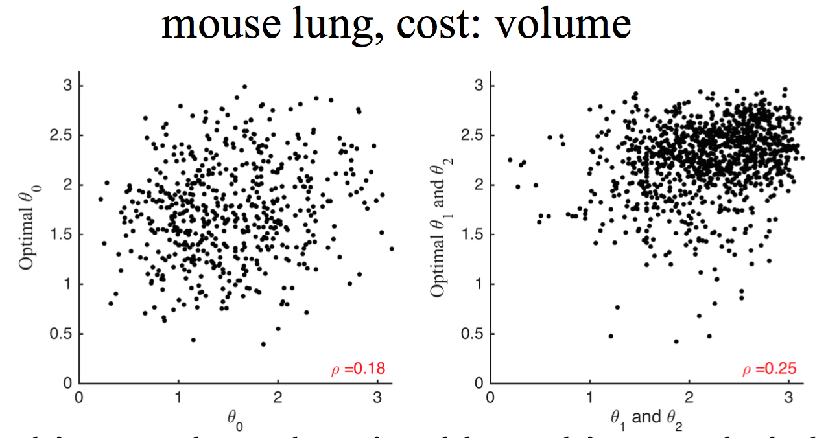
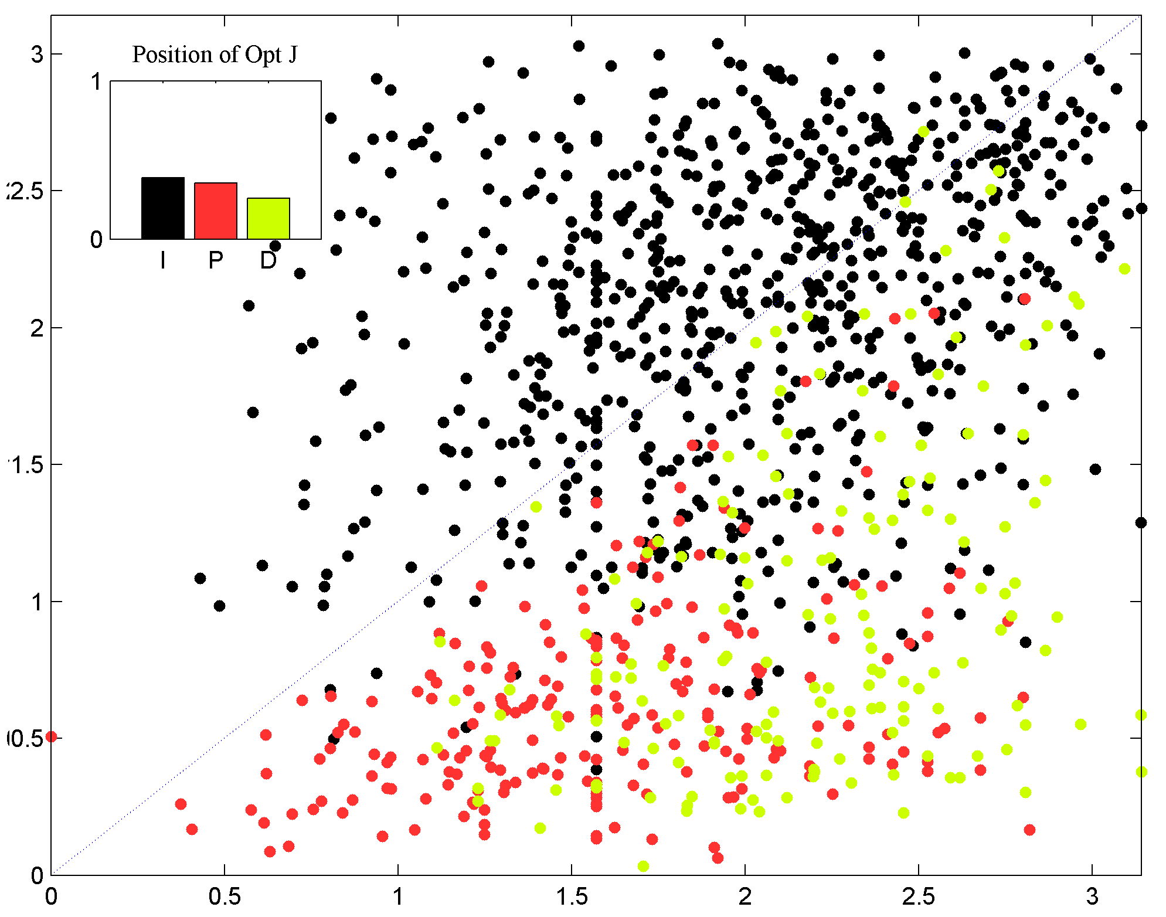
node-level comparison
Tekin and Savage, in prep.

Slide 37
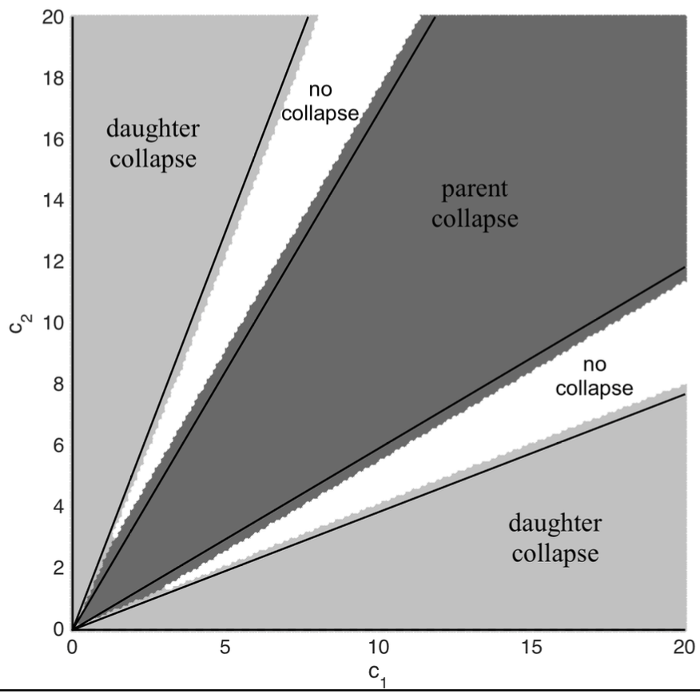
optimizing for flow and power loss cannot be done at single branching
Tekin and Savage, in prep.

Slide 38
random branching from node level to intermediate to network level

Slide 39
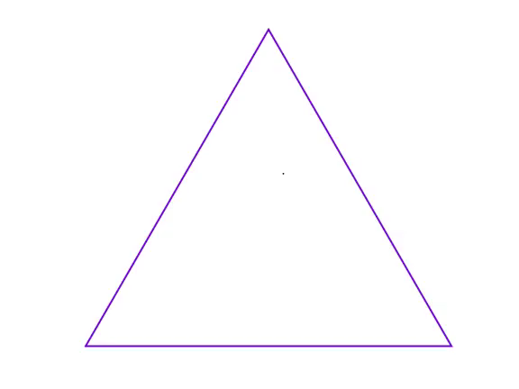
local constraint
For each triangle create 1000 random points inside each triangle
Tekin and Savage, in prep.

Slide 40
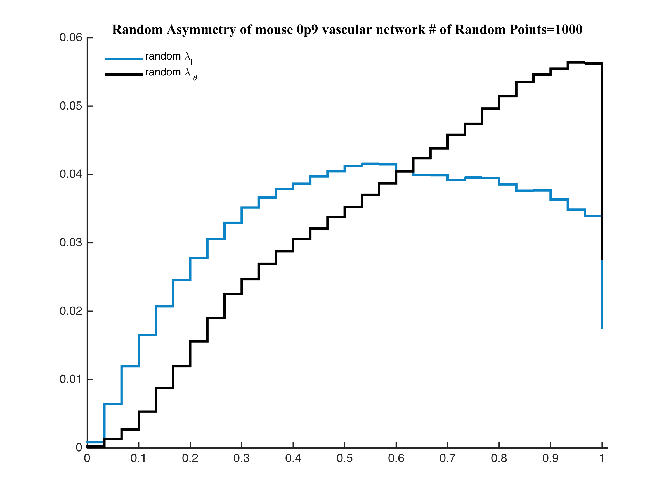
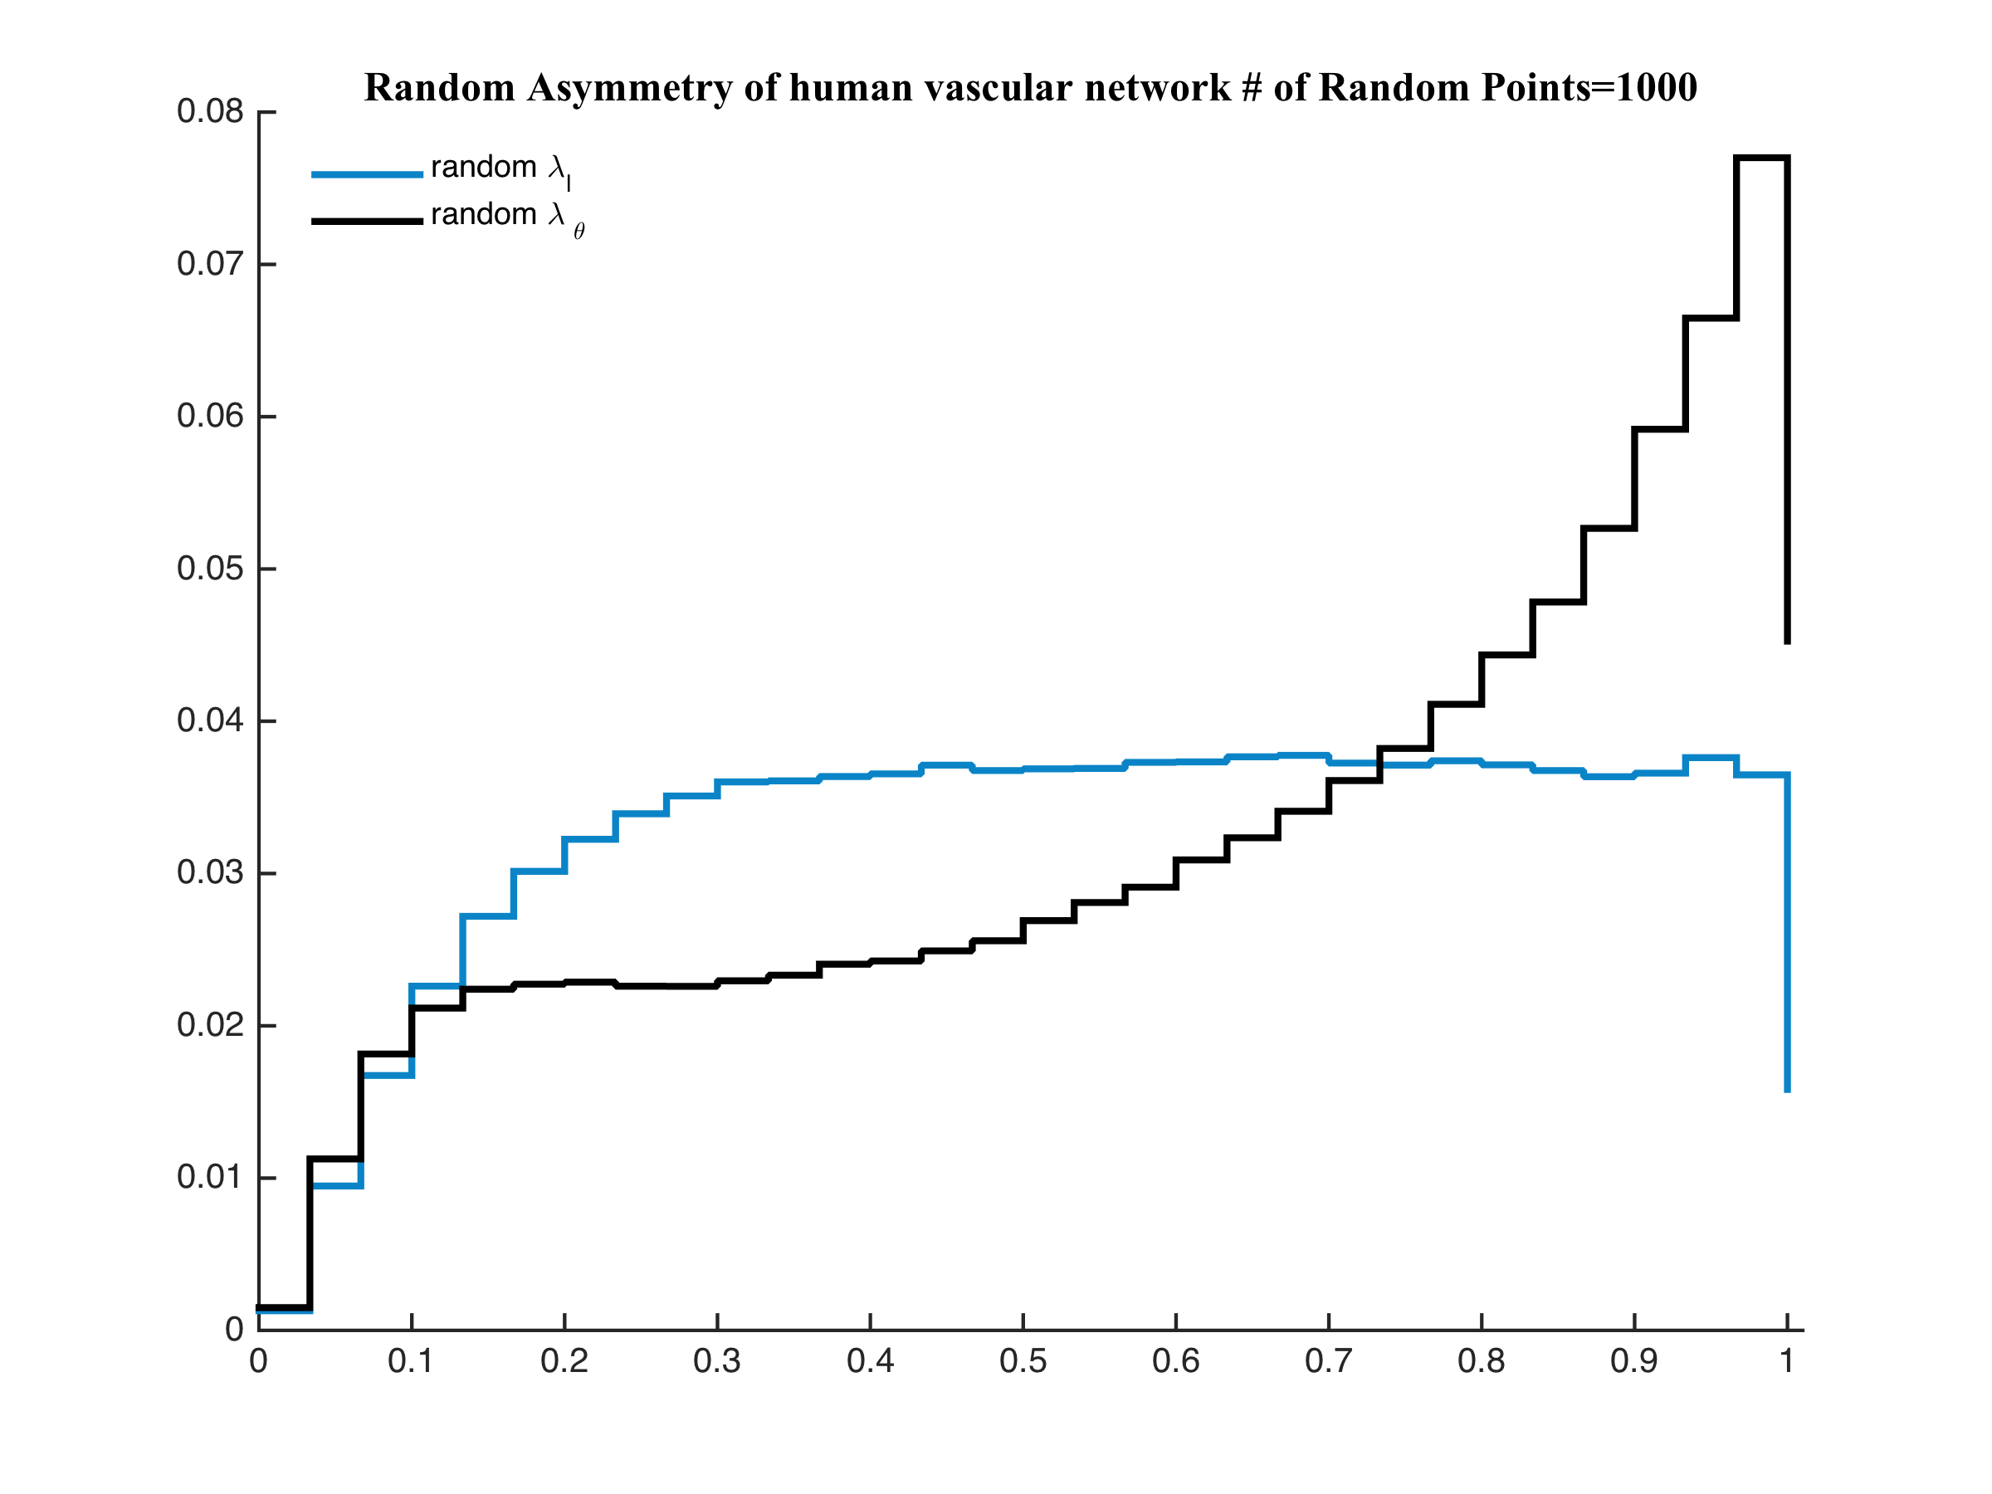
comparison to empirical data
mouse
human
Tekin and Savage, in prep.

Slide 41
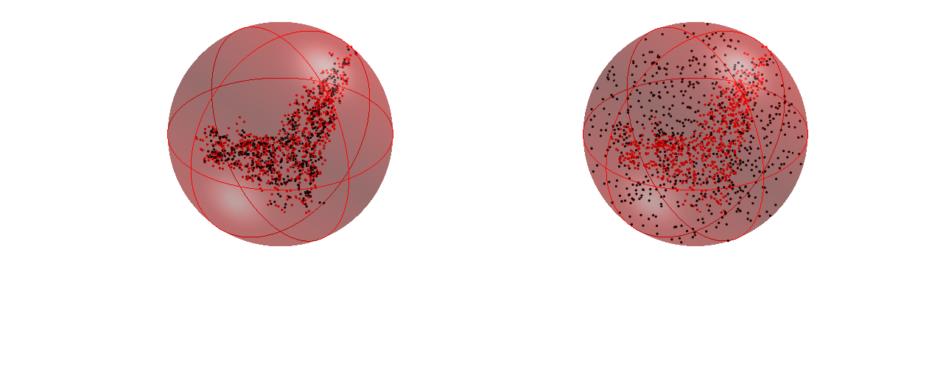
global constraint randomly place nodes within whole sphere with fixed terminal tips
real mouse data
simulated mouse data
Tekin and Savage, in prep.

Slide 42
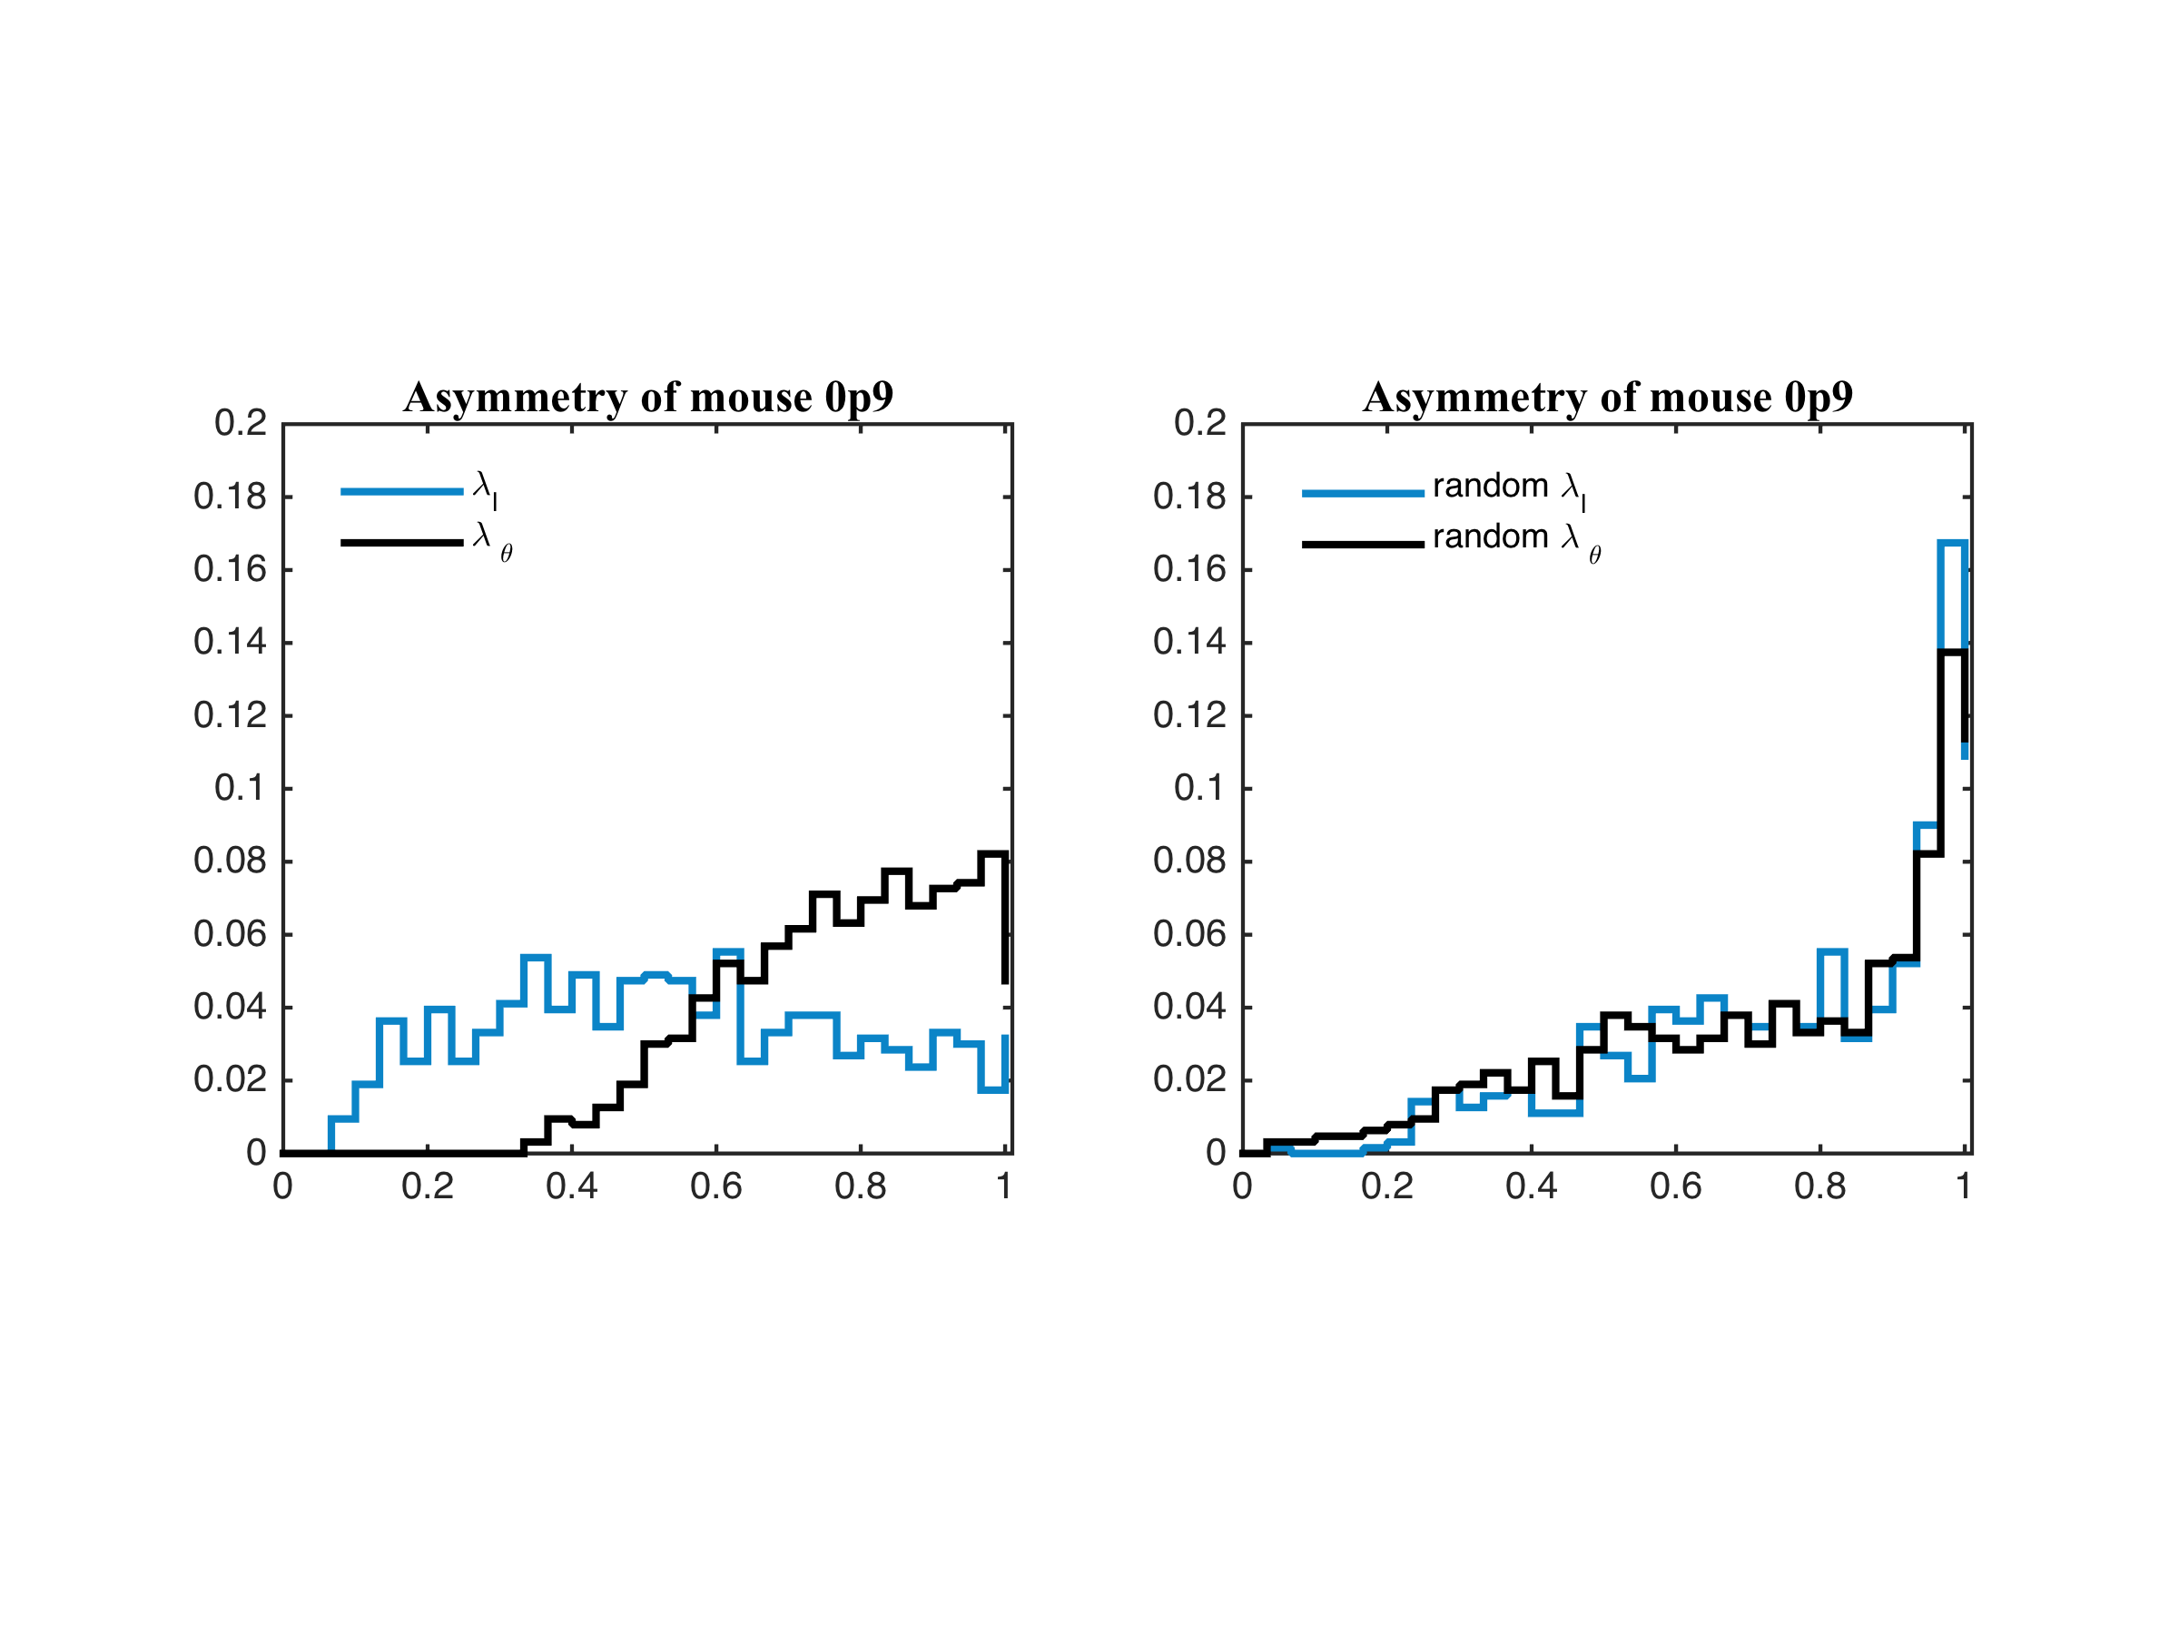
not a match to empirical data
Tekin and Savage, in prep.

Slide 43
Intermediate constraint network built by random placement with distance scale set by vessel size
Start from the first branching
Continue down towards tips
Tekin and Savage, in prep.

Slide 44
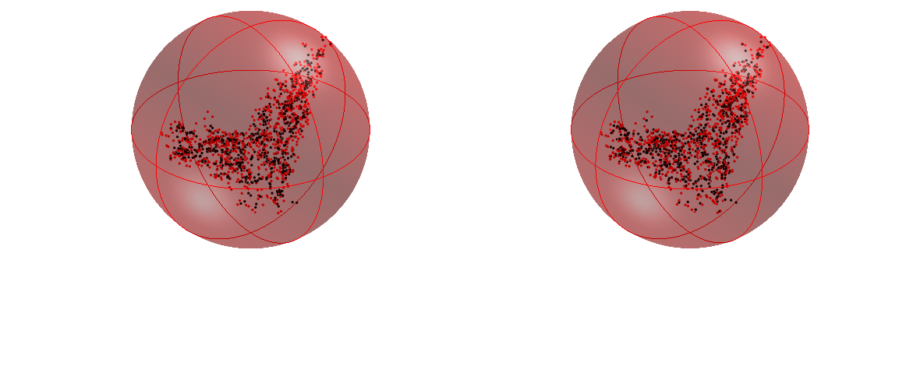
whole network
real mouse data
simulated mouse data
Tekin and Savage, in prep.

Slide 45
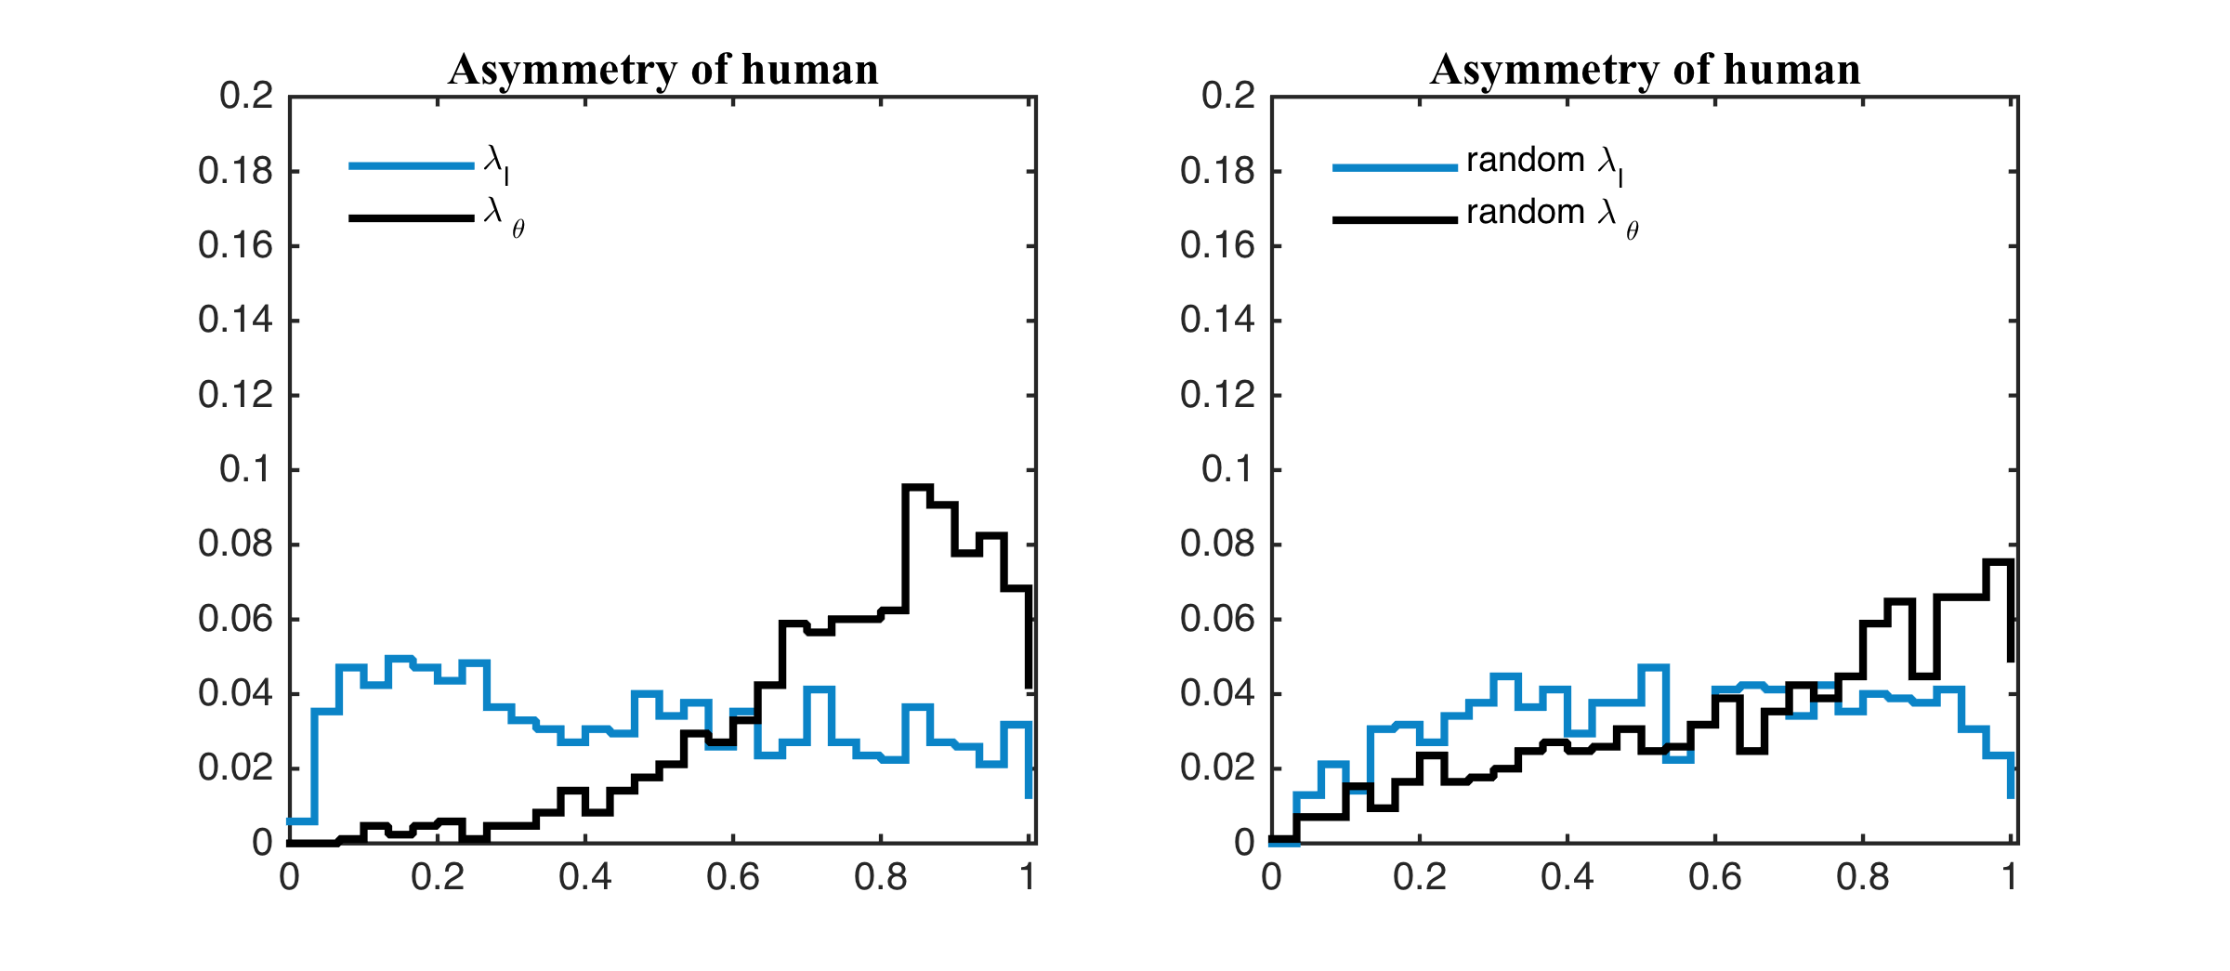
Rough match to empirical data
Tekin and Savage, in prep.

Slide 46
simulations of space filling networks with local and global constraints

Slide 47
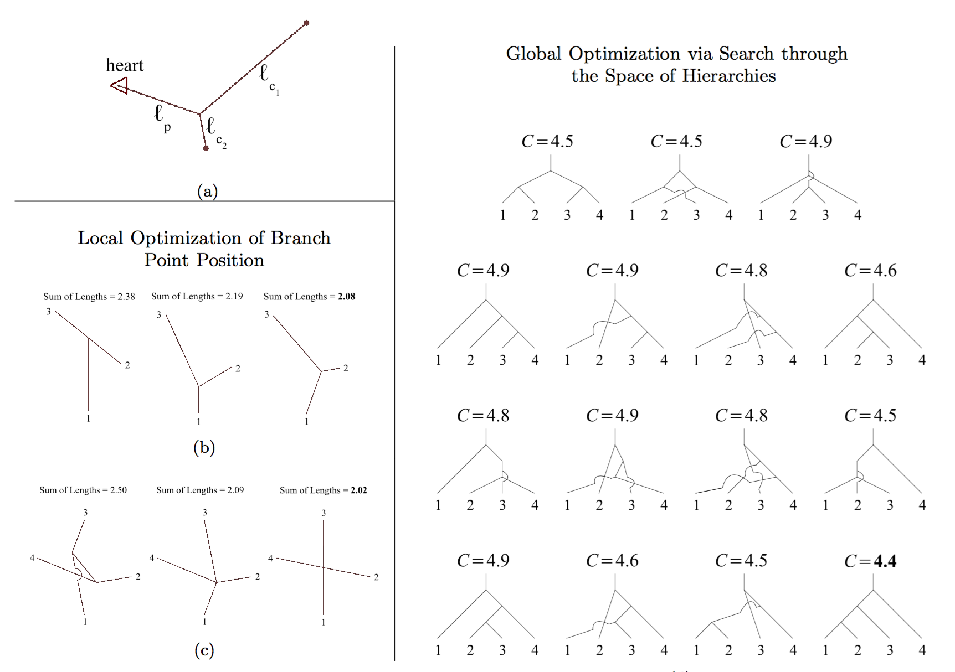
Hunt and Savage, Phys. Rev. X, in review

Slide 48
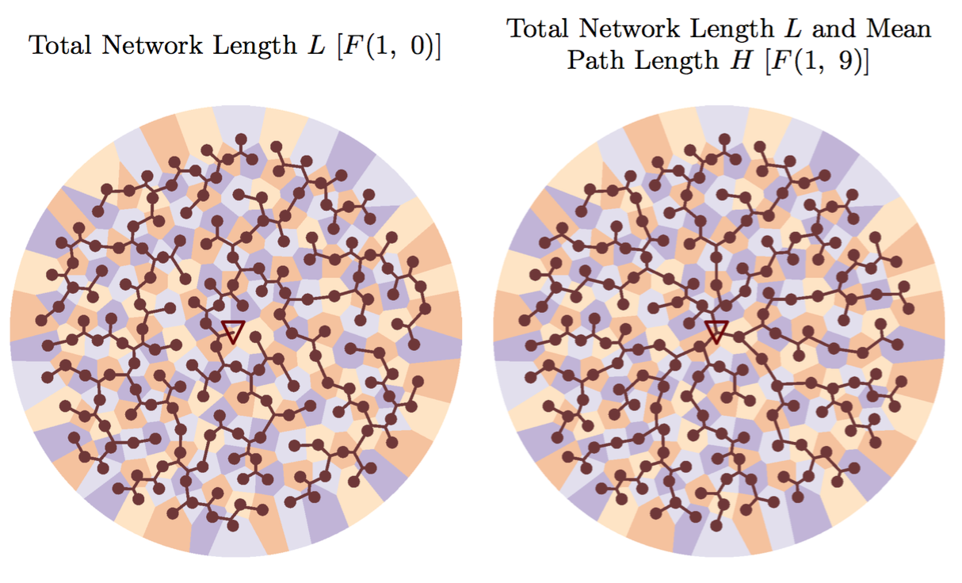
different optimizations yield different network architectures
Hunt and Savage, Phys. Rev. X, in review

Slide 49
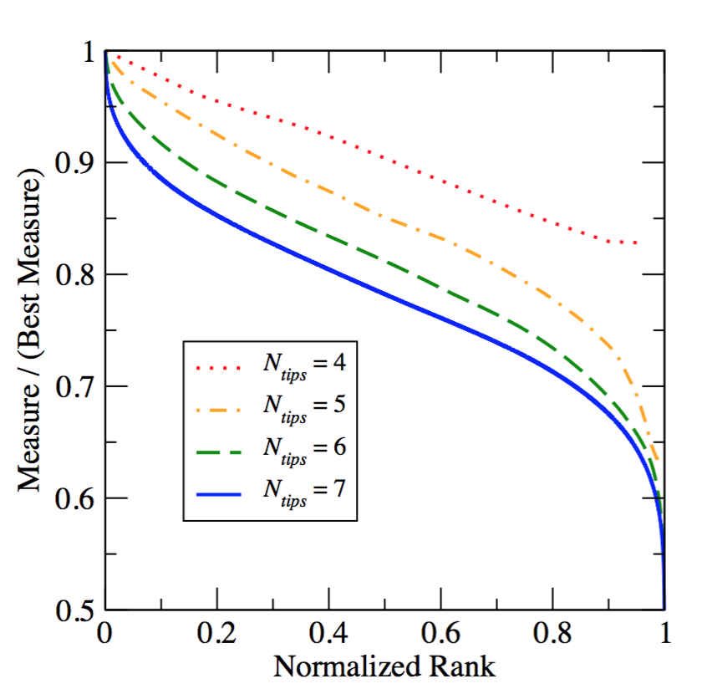
fitness landscapes
Hunt and Savage, Phys. Rev. X, in review

Slide 50
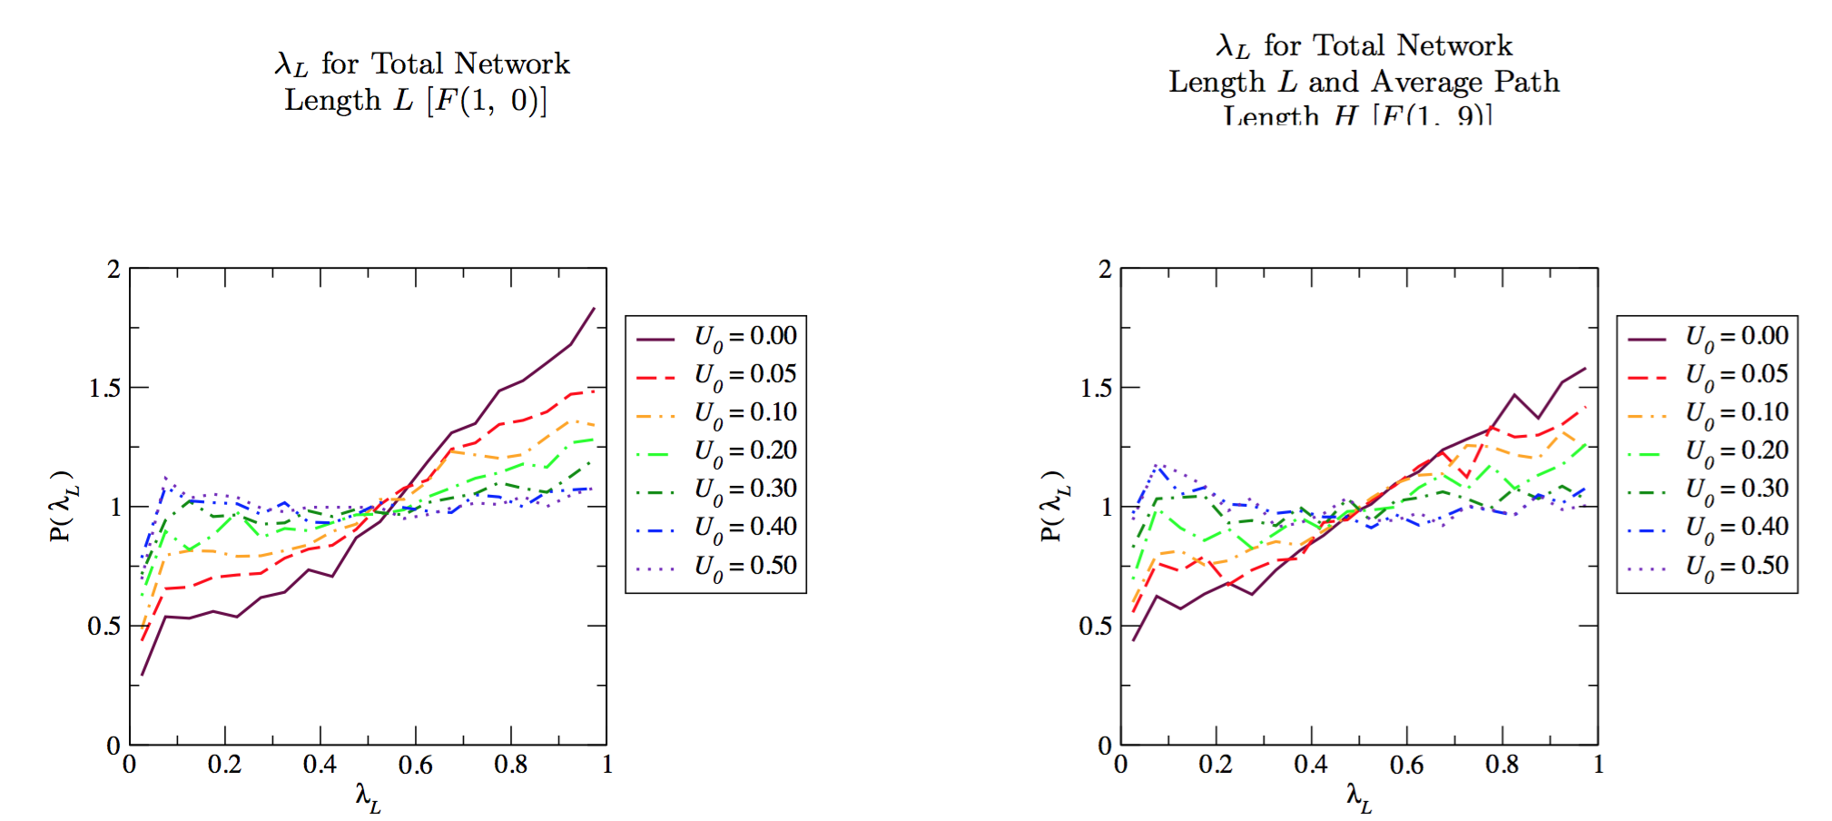
need proxy for radius information to get realistic asymmetry distributions
Hunt and Savage, Phys. Rev. X, in review

Slide 51
tumor growth

Slide 52
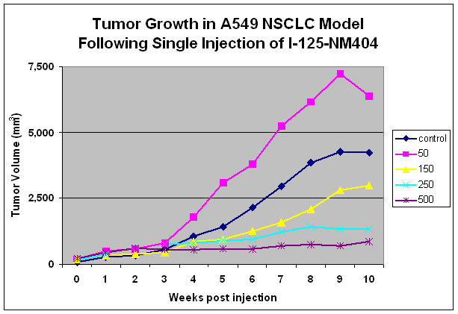
tumor growth trajectories: efficacy of drugs
www.cellectar.com
Notes:
Tumor growth trajectories are commonly used as a measure of drug efficacy. Tumor growth
Is strongly tied to metabolic rate which gives the power to drive growth, and as we have seen,
Metabolic rate is strongly tied to the structure of the vascular system. So, what I want to do
Is focus on the structure of the vascular system as well as properties of tumor cells to understand
What happens to metabolic rate and growth rate as the tumor grows.

Slide 53
tumor growth: energetics
Total metabolic
rate for
maintenance
and growth
Rate of
production
of new cells
for growth
and
replacement
Number
of viable
cells
Cellular
metabolic
rate for
maintenance
Energy to
create a
new cell
Probability of cell death is independent of tumor size
Rate of cell
death
Herman, Savage, West, PLoS One, 2011

Slide 54
original growth equation becomes
using N_{v}=m_{v}/m_{c} and defining B_{c}=B_{c,m}-ΓE_{c}
How does B_{T} depend on m_{v}?
Herman, Savage, West, PLoS One, 2011

Slide 55
What does this architecture mean for tumor growth?
p=1/(2a+b) and logistic for 2a+b>1 (healthy tissue and large tumors?)
=1 and exponential for 2a+b<1 (all tumors?)
Herman, Savage, West, PLoS One, 2011

Slide 56
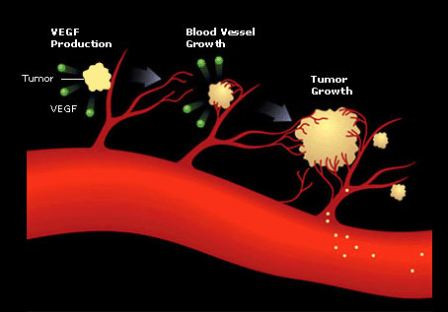
two regimes of growth: Pre- and post-angiogenesis

Slide 57
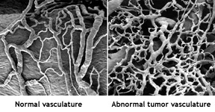
How does tumor vasculature compare to normal vasculature?
Notes:
Tumor vasculature is famous for being aberrant!
Not as hierarchical! Not as regular! Not as space filling,
Although you can’t see it here. Some regions have much
Denser vasculature than normal tissue and others
Have completely empty spaces and become necrotic.

Slide 58
phase 1: pre-angiogenesis
oxygen and nutrients come by diffusion
from nearby capillaries
Herman, Savage, West, PLoS One, 2011

Slide 59
phase 1: Pre-angiogenesis
At start all tumor mass is viable, m_{T}=m_{V}
exponential growth. resources deplete and
can’t continue to get all nutrients
that normal tissue would have received.
Herman, Savage, West, PLoS One, 2011

Slide 60
phase 2: angiogenesis
oxygen and nutrients from capillaries in tumor’s vasculature
small
vessels
to zeroth-order tumor is like its own small organism, but
vascular structure may be different and must interface with
host vasculature
Notes:
We know by measuring properties of healthy vasculature ties to met rate, How does that work for tumors?

Slide 61
back to tumor growth

Slide 62
Are network exponents for tumor vasculature similar to normal tissue?
Exponents are shallower, breakdown in hierarchy, scaling is more variable
Savage et al., in review at Discrete and Continuous Dynamical Systems-B
Notes:
Exponents are shallower
Breakdown in hierarchy and scaling.
Also, much more variable.

Slide 63
Are network exponents for tumor vasculature similar to normal tissue?
exponents are shallower, breakdown in hierarchy, scaling is more variable
Savage et al., in review at Discrete and Continuous Dynamical Systems-B
Notes:
Exponents are shallower
Breakdown in hierarchy and scaling.
Also, much more variable.

Slide 64
table of all fits and averages
2a+b<1 appears to hold, so θ≈1, implying exponential tumor growth
Savage et al., Discrete and Continuous Dynamical Systems-B

Slide 65
universal curve to compare tumor growth and ontogenetic growth
Savage et al., Discrete and Continuous Dynamical Systems-B

Slide 66
Dependence on host size
pre- and early angiogenesis: Metabolic rate of tumor has pre-factor that depends on
also, this pre-factor is part of the time constant
this may set natural time scales across species for growth,
occurrence rates, drug dosing, etc.

Slide 67
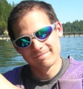
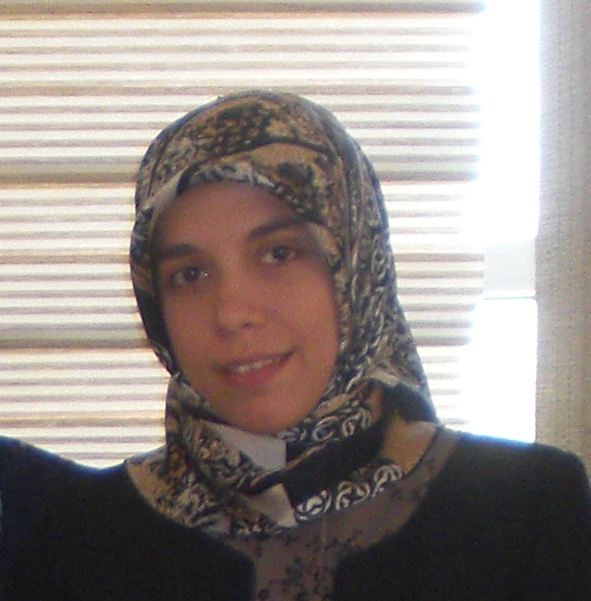

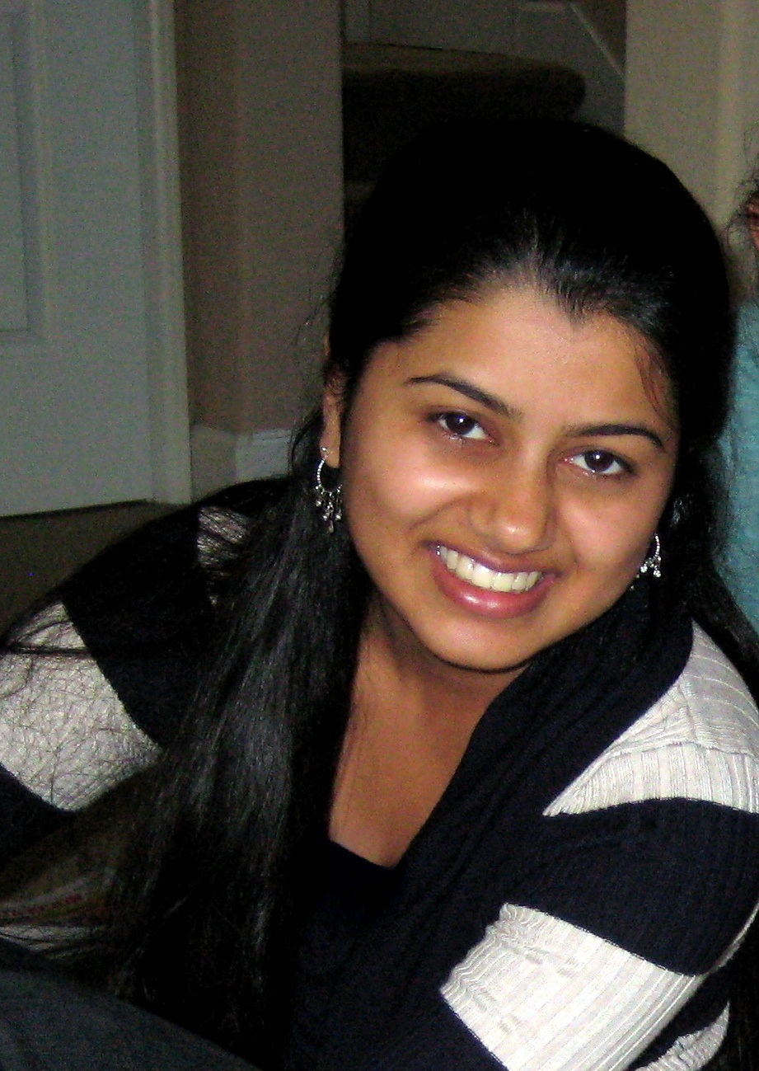
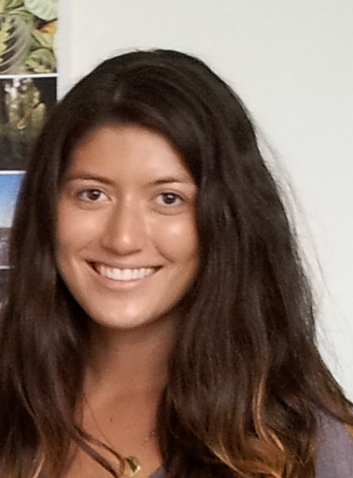


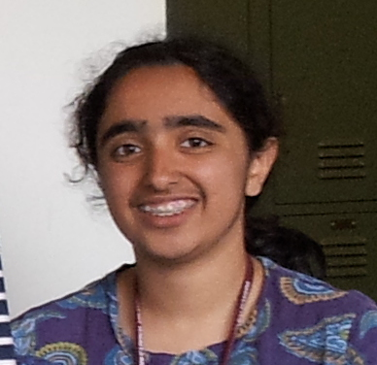

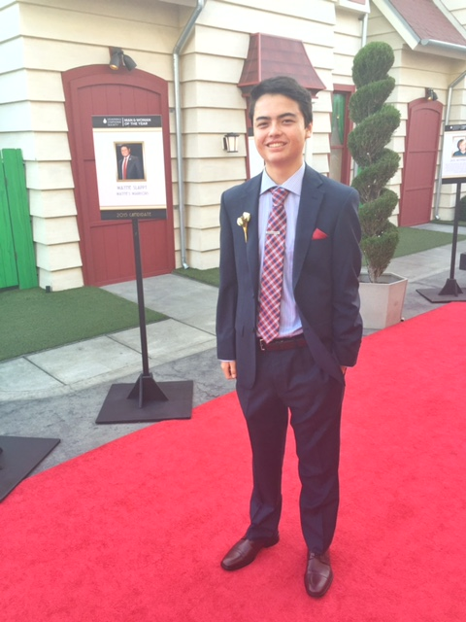


current and former postdocs
current and former graduate students
David Hunt
Elif Tekin
Mitchell Newberry
current and former undergraduate students
Preeti Chayapathi
Kathryn Burch
Ben Demaree
Angelicia Thomas
Maya Josyula
Shanice Seawright
Quentin Lepak
Matthew Aquilina
Edward Hu
Aditya Athota
Daniel Ennis (Dept. of Radiological Sciences, David Geffen School of Medicine at UCLA)
Kristina Bostrom (Dept. of Medicine, David Geffen School of Medicine at UCLA)
Notes:
FINALLY, THANKS TO ALL MY COLLABORATORS FROM MULTIPLE FIELDS AND TO THE AGENCIES THAT ARE HELPING TO FUND THIS WORK.

Slide 68

Funding
Notes:
FINALLY, THANKS TO ALL MY COLLABORATORS FROM MULTIPLE FIELDS AND TO THE AGENCIES THAT ARE HELPING TO FUND THIS WORK.I THINK MBI IS A SIMILAR PLACE TO SFI AND WOILD BE A STIMULATING AND EXCITING PLACE TO WORK!
Say physicist, biochemist, and biologists to show you go the spectrum. Plug for interdisciplinary

